Slide 1
Introduction to HTML & CSS
Weightage-11M

Slide 2
Course outcome
Create simple web pages using HTML and CSS.

Slide 3
Introduction to html
• HTML stands for HyperText Markup Language
• Developed by Tim Berners-Lee in 1991
• Latest version: HTML5
• Structures content on the web
• Provides skeleton of a webpage

Slide 4
Why HTML is Used?
Create web pages & applications
Defines structure of webpage
Works with CSS & JavaScript
Not a programming language
Essential for web development

Slide 5
HTML Page Structure

Slide 6
Different Types of Tags in HTML
The root element always contains a <head> and a <body> element.
1. Root element tag
The root element always contains a <head> and a <body> element.

Slide 7
2. Head element tag
<head> element is like a container that contains the information about the document
<title> element is one mandatory element within the <head> element. This title is displayed as the page title in the browser tab and also the search engines identify the page
<head>
<title>This is a page title </title>
</head>

Slide 8
3.Body element tag
All the content that is visible in a browser is contained within the <body> element
Example
<body>
<h1>This is a heading</h1>
</body>

Slide 9
HTML <link> href Attribute
<link href="URL">
The URL of the linked resource/document Possible values: An absolute URL - points to another web site (like href="http://www.example.com/theme.css") A relative URL - points to a file within a web site (like href="/themes/theme.css")

Slide 10
What is CSS?
CSS stands for Cascading Style Sheets
CSS describes how HTML elements are to be displayed on screen, paper, or in other media
CSS saves a lot of work. It can control the layout of multiple web pages all at once
External stylesheets are stored in CSS files

Slide 11
Why CSS?
CSS is used to define styles for your web pages, including the design, layout, and variations in display for different devices and screen sizes.

Slide 12
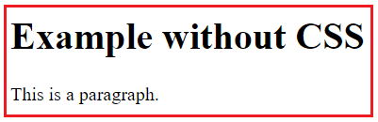
Example without using CSS code with output:
<!DOCTYPE html>
<html>
<head>
</head>
<body>
<h1>Example without CSS</h1>
<p>This is a paragraph.</p>
</body>
</html>

Slide 13
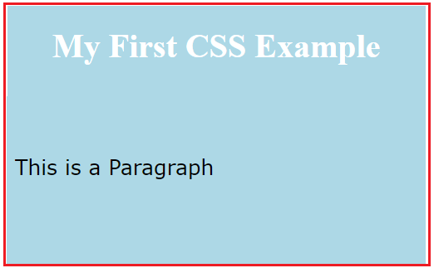
Example with CSS (Code with output):
<!DOCTYPE html>
<html>
<head>
<style>
body {
background-color: lightblue;
}h1
color: white
text-align: center;}
p { font-family: verdana;
font-size: 20px;
}</style>
</head>
<body>
<h1>My First CSS Example</h1>
<p>This is a paragraph.</p>
</body>
</html>

Slide 14
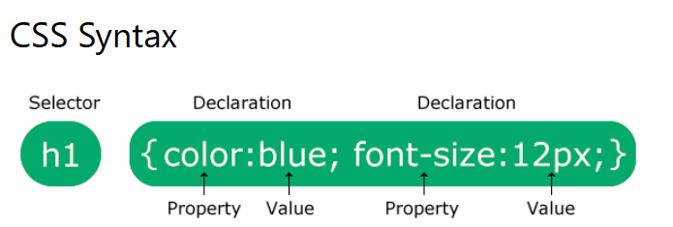
Syntax of css
A CSS rule consists of a selector and a declThe selector points to the HTML element you want to style.
The declaration block contains one or more declarations separated by semicolons.

Slide 15
Types of CSS
Inline
Internal
External

Slide 16
INLINE CSS
Inline CSS is applied directly to an HTML element using the style attribute.
<!DOCTYPE html>
<html>
<body>
<h1 style="color: blue; text-align: center;">Inline CSS Example</h1>
<p style="color: red;">This paragraph uses inline CSS.</p>
</body>
</html>

Slide 17
Internal CSS:
Internal CSS is defined within a <style> tag inside the <head> section of the HTML document.
<!DOCTYPE html>
<html>
<head>
<style>
body {
background-color: lightgray;
}
h1 {
color: green;
text-align: center;
}
p {
color: purple;
}
</style>
</head>
<body>
<h1>Internal CSS Example</h1>
<p>This paragraph uses internal CSS.</p>
</body>
</html>

Slide 18
External CSS: External CSS is written in a separate .css file and linked to the HTML document using a <link> tag.
HTML file
CSS file
<!DOCTYPE html>
<html>
<head>
<link rel="stylesheet" href="styles.css">
</head>
<body>
<h1>External CSS Example</h1>
<p>This paragraph uses external CSS.</p>
</body>
</html>
body {
background-color: beige;
}
h1 {
color: navy;
text-align: center;
}
p {
color: darkred;
}

Slide 19
THANK YOU

